Slide 1
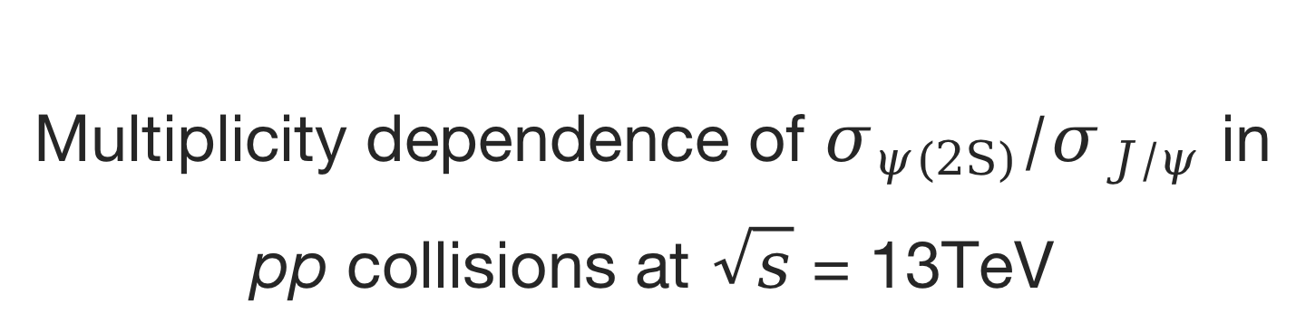
Multiplicity dependence of $σ_{ψ(2S)}/σ_{J/ψ}$ in pp collisions at $\sqrt{s}$ = 13TeV
Youen Kang
Tsinghua University
Notes:
Hello everyone
this is youen Kang from Tsinghua University
My analysis is, multiplicity dependence of psi(TwoS) to J/psi production ratio in pp collisions at center of mass energy thirteen TeV.

Slide 2
Outline
Introduction
Data Sets
Analysis
Signal extration
Efficiency and Systematic Uncertainty
Results
Notes:
This is the outline of the presentation.

Slide 3
Introduction
Notes:
First is the introduction part.

Slide 4
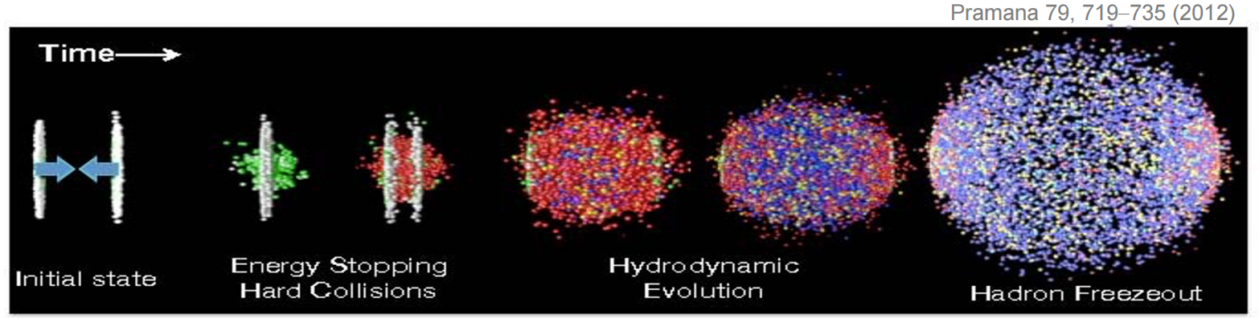
Heavy quarkonium production
Heavy quarkonium production is an excellent probe for nuclear matter effect in heavy-ion collisions.
Heavy quarks are produced in itial hard scattering.
Heavy quarks experience whole time evolution.

Slide 5
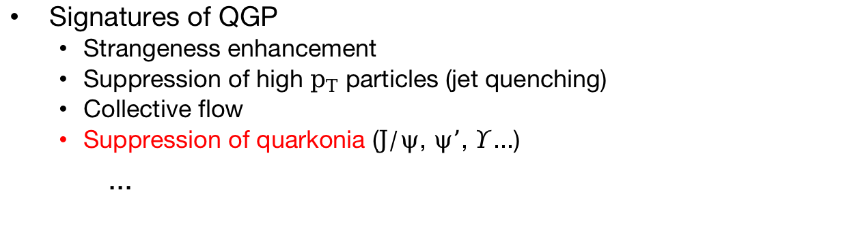
Nuclear Matter effect
Collision Systems
A-A collisions: Hot Nuclear Matter (HNM) effect dominates, related to the QGP production.
p-A collisions: Cold Nuclear Matter (CNM) effect dominates, including initial-state effect like energy loss in multi-particles scattering, nuclear Parton Distribution Functions (nPDFs) and final-state effect like nuclear absorption and co-mover effect.
pp collisions: No Nuclear Matter effect expected to exist.
Large systems
Small systems
Signatures of QGP
Strangeness enhancement
Suppression of high $p_{T}$ particles (jet quenching)
Collective flow
Suppression of quarkonia ($J/ψ$, $ψ’$, $Υ$...)
...
Has been observed in Large and high-multiplicity Small systems.
Need verification

Slide 6
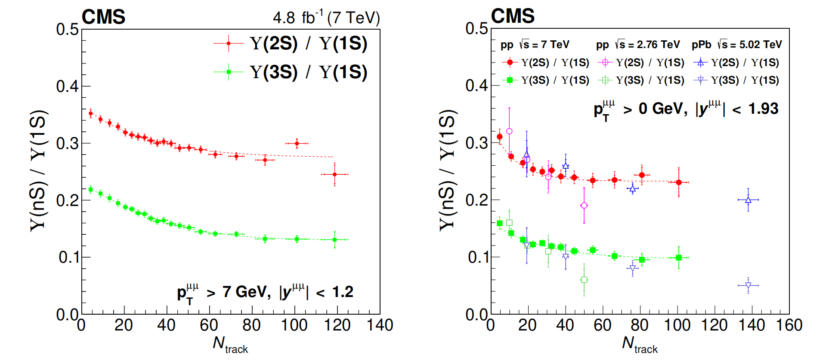
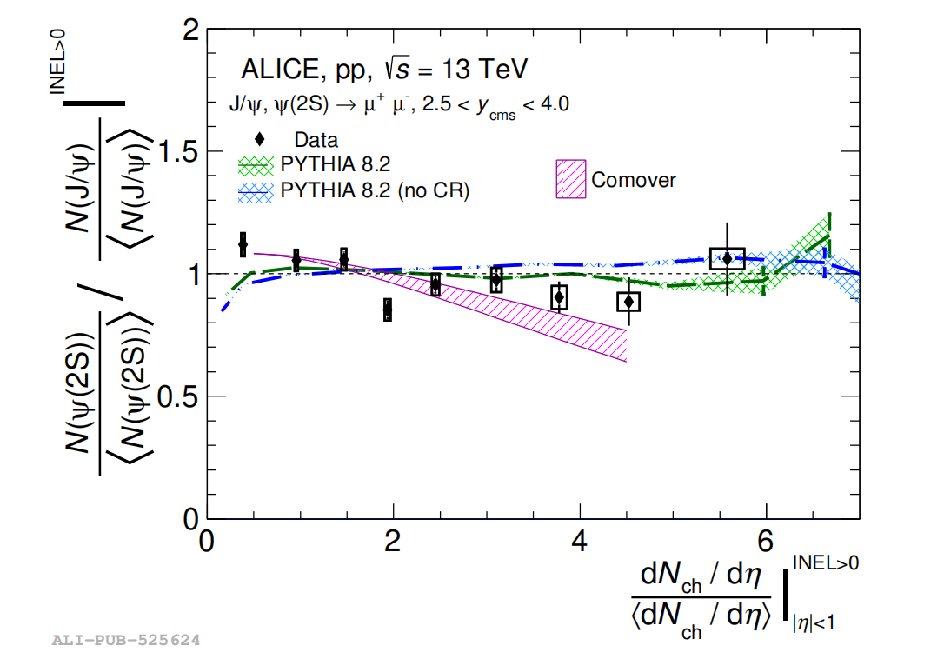
Excited-to-ground ratio of quarkonium in pp collisions
Initial-state effects like PDF, energy loss due to multi-particle scatterings will be canceled out.
Final state effects and potential existence of QGP need be taken into consideration.
CMS [JHEP11(2020)001]
ALICE [JHEP 06 (2023) 147]

Slide 7
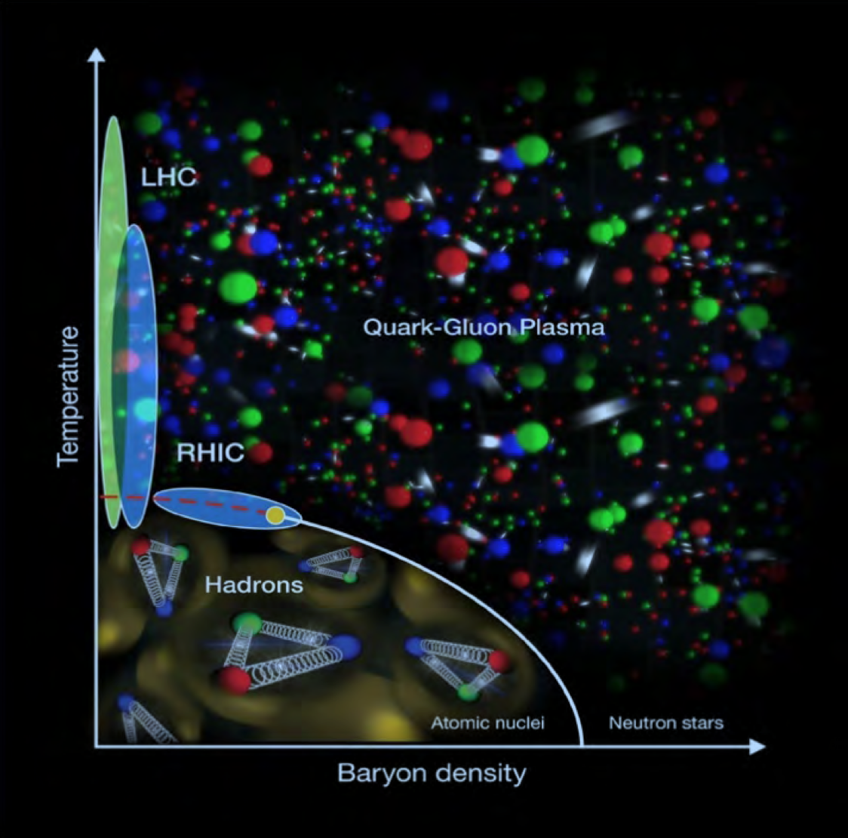
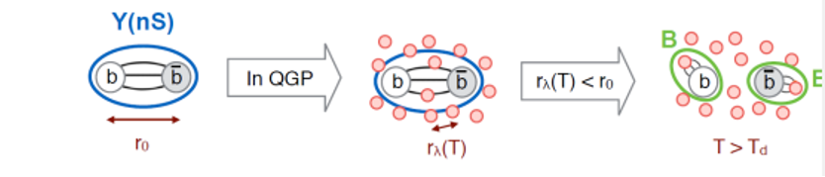
Heavy quarkonium in QGP
Quark-Gluon Plasma (QGP):
A thermally equilibrated system where partons are deconfined from the hadrons.
Achieve either by heating or compression of nuclei.
May exist in the early stage of universe, the core of neutron stars and ultra-relativistic energy heavy ion collisions.
Color screening:
High density of free color charges leads to color screening and dissociation of heavy quarkonium.
A schematic of QCD phase diagram
Potential existence of QGP in high multiplicity pp collisions might cause the suppression on ratio.
Notes:
提一嘴sequential suppression

Slide 8
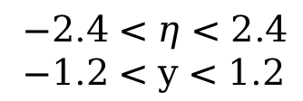
Co-mover effect
‘Quarkonia are suppressed by interaction with the co-moving medium, constituted by particles with similar rapidities.’ [JHEP 03 (2019) 063]
Multiplicity measured in: $−1<η<1$
Production measured in : $2.5<y<4$
$−2.4<η<2.4$
$−1.2<y<1.2$
Correlation between multplicity and production measurements might cause the suppression on ratio.

Slide 9
Data sets
Notes:
Then we come to the analysis part

Slide 10
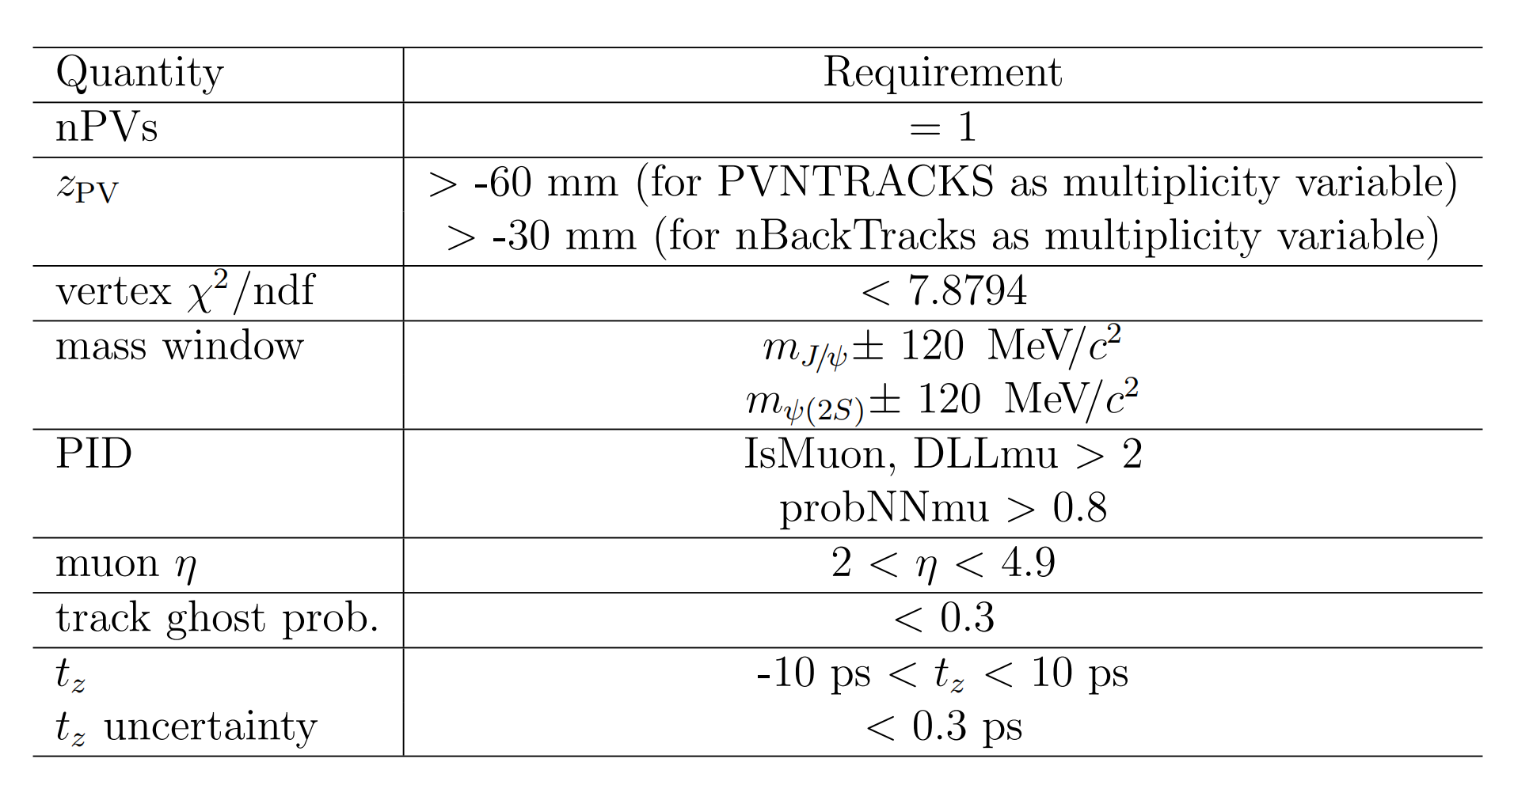

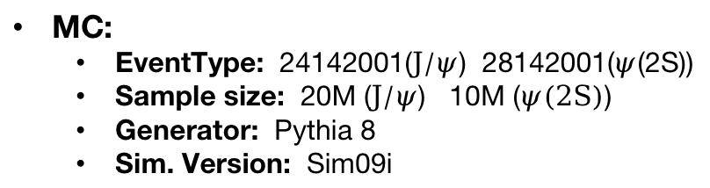
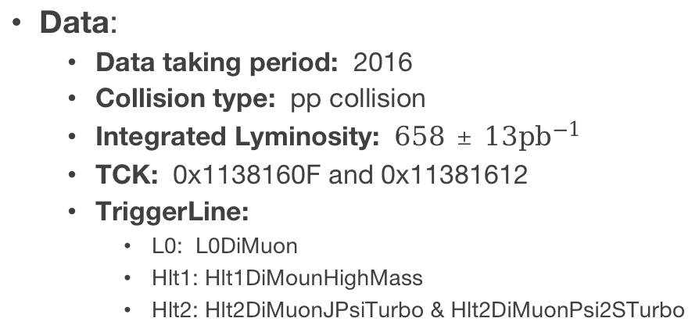
Data set
Data:
Data taking period: 2016
Collision type: pp collision
Integrated Lyminosity: $658±13{pb}^{−1}$
TCK: 0x1138160F and 0x11381612
TriggerLine:
L0: L0DiMuon
Hlt1: Hlt1DiMounHighMass
Hlt2: Hlt2DiMuonJPsiTurbo & Hlt2DiMuonPsi2STurbo
Offline selection
MC:
EventType: 24142001($J/ψ$) 28142001($ψ$(2S))
Sample size: 20M ($J/ψ$) 10M ($ψ(2S)$)
Generator: Pythia 8
Sim. Version: Sim09i
Decay Channel:
$J/ψ→μ^{+}+μ^{−}$
$ψ(2S)→μ^{+}+μ^{−}$
Notes:
Here is a breif introduction of the date set we use in the analysis.
The decay channels are Jpsi and Psi(TwoS) to dimuon.
The study here uses pp collision data
collected by the LHCb detector at a center-of-mass energy of Thirteen TeV in 2016
with a corresponding luminosity of six hundred and fifty-eight inverse pico barns.
To enlarge the sample size, two different TCKs with same restrictions on muon cut are applied.
And the offline selection is summarized in the right table.

Slide 11
Analysis
Notes:
Then we come to the analysis part

Slide 12
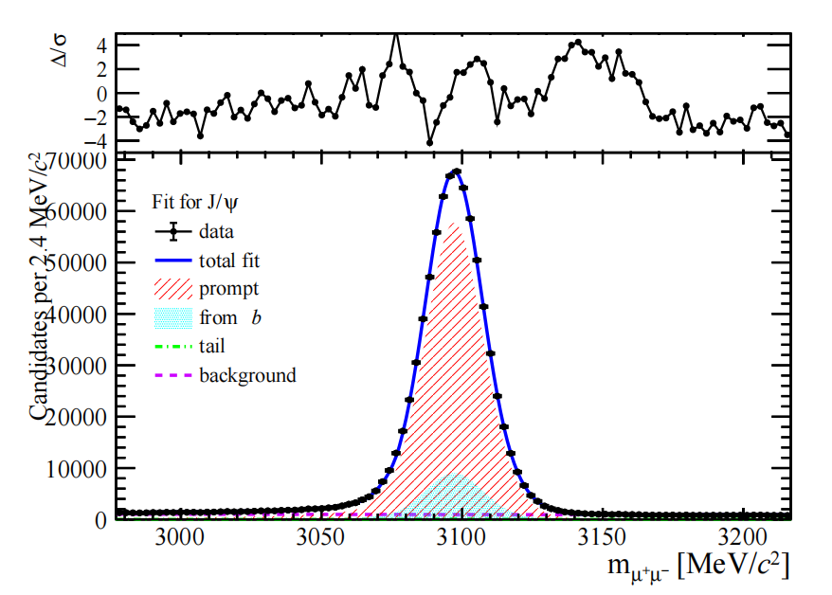
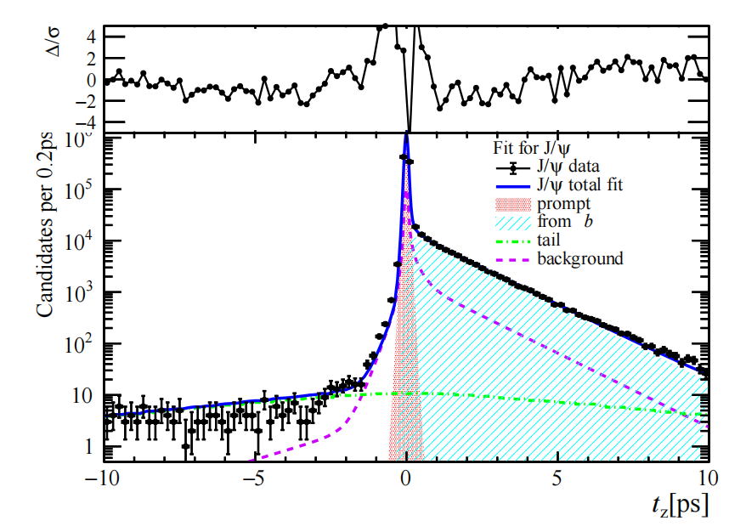
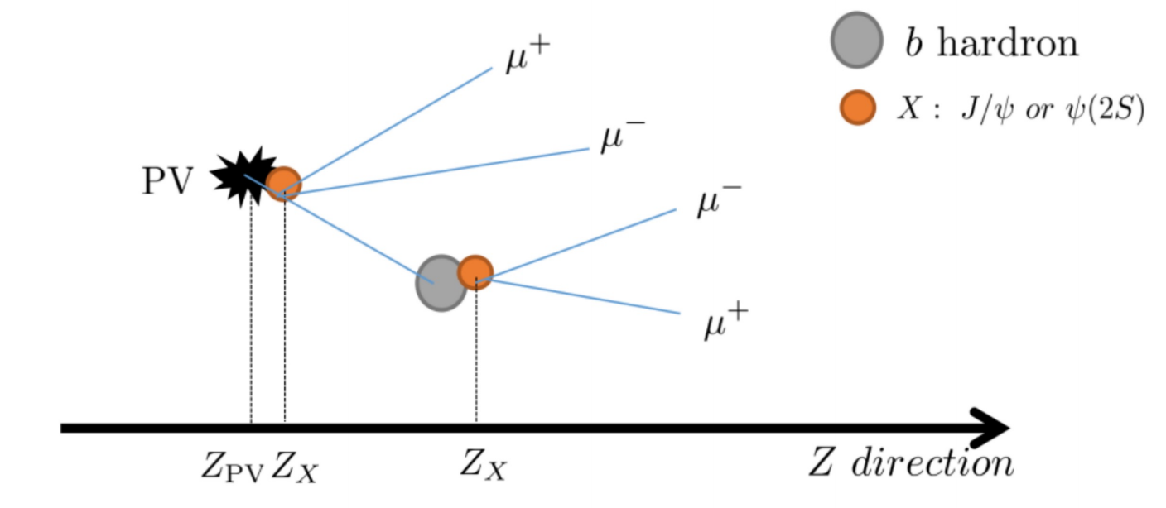
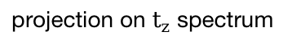
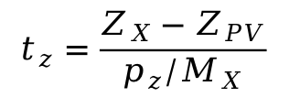
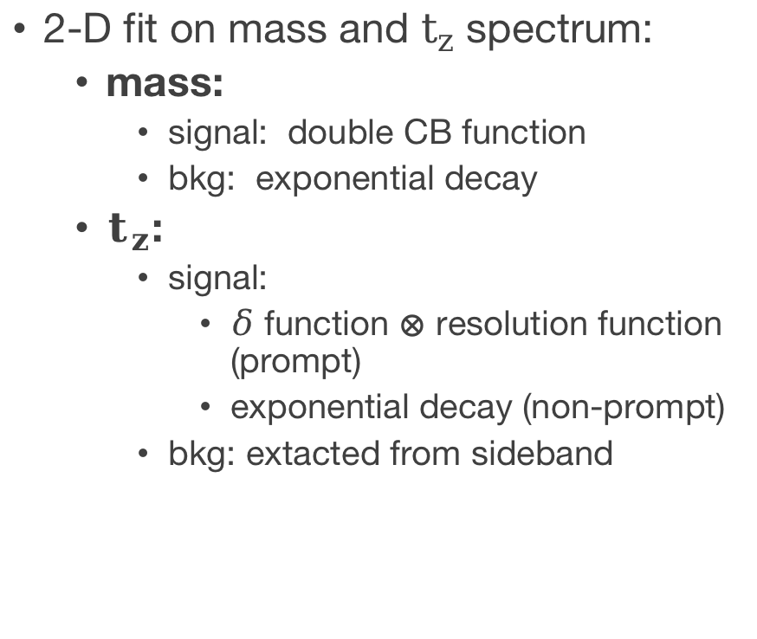
Signal extraction
2-D fit on mass and $t_{z}$ spectrum:
mass:
signal: double CB function
bkg: exponential decay
$t_{z}$:
signal:
$δ$ function $⊗$ resolution function (prompt)
exponential decay (non-prompt)
bkg: extacted from sideband
projection on mass spectrum
projection on $t_{z}$ spectrum
$$t_{z}=\frac{Z_{X}−Z_{PV}}{p_{z}/M_{X}}$$
Definition of pseudo-decay time:
Notes:
To extract the signal yields,
a two dimensional fit is performed where for mass fit,
a double crystal function is used to describe the signal and an exponential deacy to describe background.
For pseudo-decay time tz, which is defined as the following formula,
it represents the time between the production and decay of a charmonium.
The prompt signal, which is produced directly from the collisions,
is described by a delta function convolved with a resolution function.
The non-prompt signal, which comes from the decay of b-hadron,
is described by an exponential decay.
And the background shape is extrated from a sideband sample.
By the two dimension fit, we get the production of prompt and non-prompt charmonium.
On the right side is a graph for the two-dimensional fit projected in mass and tz spectrum.

Slide 13
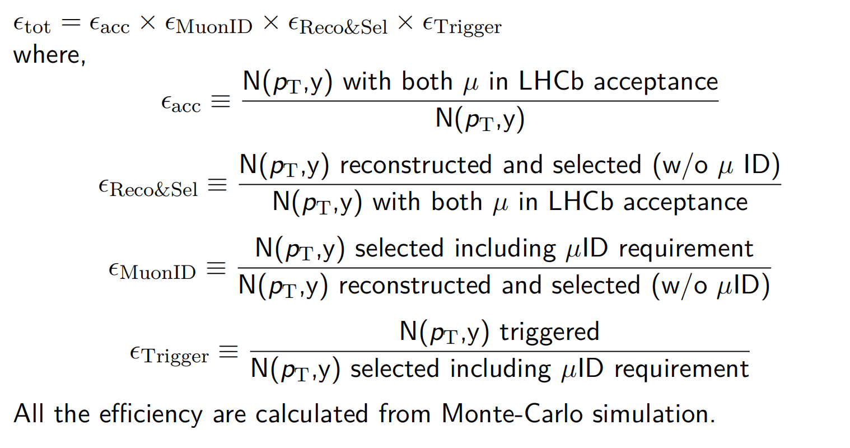
Efficiency
Notes:
Then the production is corrected by efficiency.
Where the total efficiency consist of four parts.
The geometrical acceptance,
reconstruction and selection efficiency.
And the Muon ID efficiency is obtained using simulated samples calibrated with the data using the PIDCalib package.
And finally the trigger efficiency.
Below is the difinition for efficiencies of all kind.

Slide 14

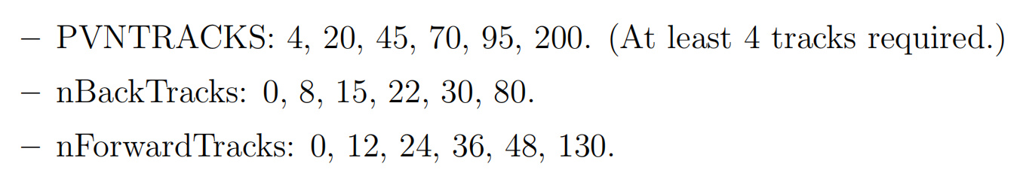
Multiplicity variables
PVNTRACKS: Number of tracks used to reconstructed primary vertex.
nForwardTRacks: Number of tracks in similar rapidity range where charmonium production is measured.
nBackTracks: Number of tracks in backward rapidity range.
Usage of nBackTracks allows to reduce the correlation of multiplicity and charmonium production measurements.

Slide 15
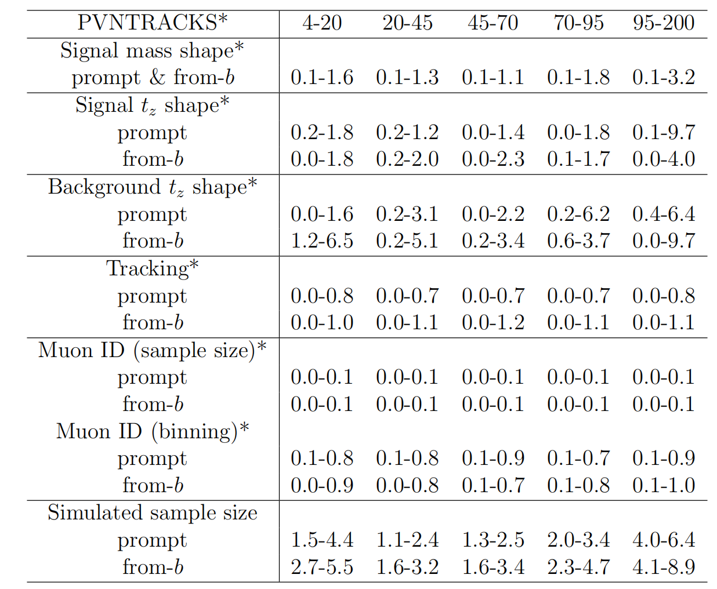
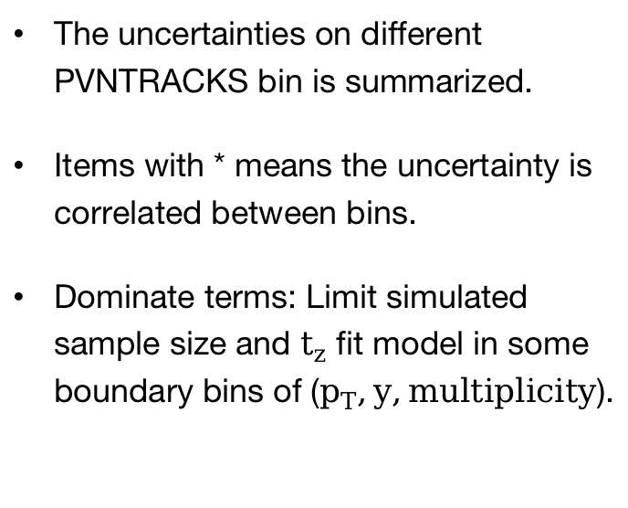
Systematic uncertainty
The uncertainties on different PVNTRACKS bin is summarized.
Items with * means the uncertainty is correlated between bins.
Dominate terms: Limit simulated sample size and $t_{z}$ fit model in some boundary bins of ($p_{T},y,multiplicity$).

Slide 16
Result
Notes:
And we get the results.

Slide 17
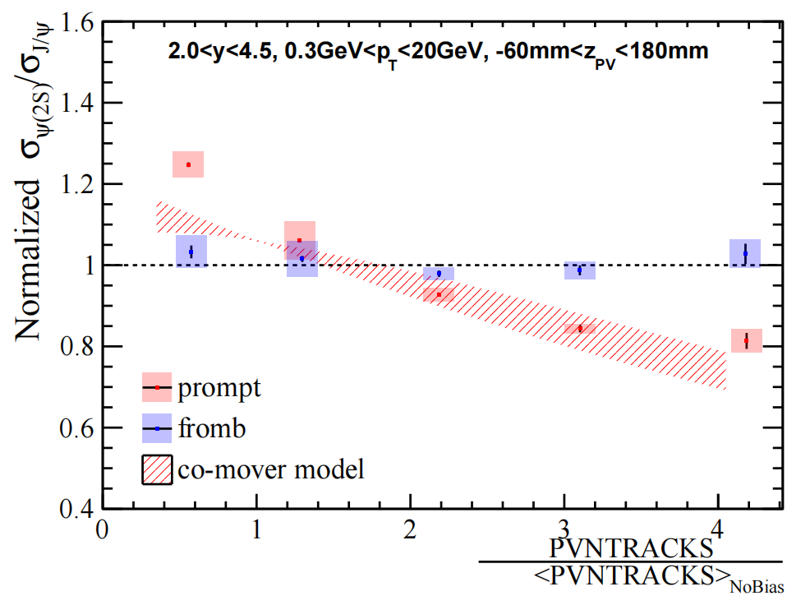
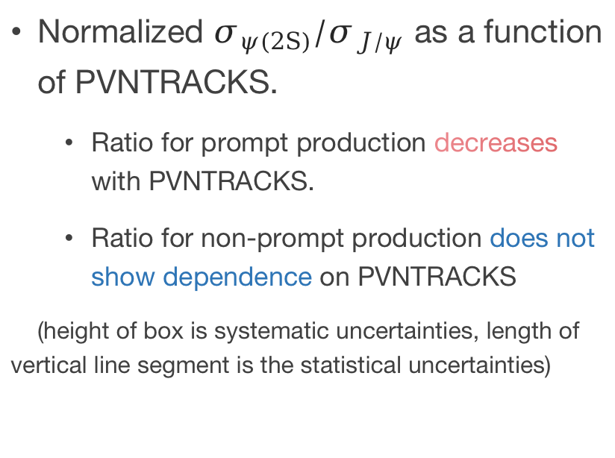
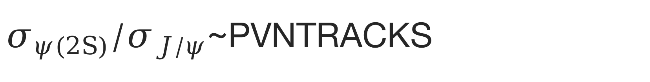
$σ_{ψ(2S)}/σ_{J/ψ}$~PVNTRACKS
Normalized $σ_{ψ(2S)}/σ_{J/ψ}$ as a function of PVNTRACKS.
Ratio for prompt production decreases with PVNTRACKS.
Ratio for non-prompt production does not show dependence on PVNTRACKS
(height of box is systematic uncertainties, length of vertical line segment is the statistical uncertainties)
Notes:
After considering all the systematic uncertainties.
We give the normalized ratio of psi(TwoS) to Jpsi production as a function of PVNTRACKS in the right graph.
PVNTRACKS on the x-axis is re-scaled by dividing the mean value of PVNTRACKS from no-bias data.
The height of box is systematic uncertainties, length of vertical line segment is the statistical uncertainties
We can clearly see that the ratio for prompt production decreases with multiplicity
while the ratio of non-prompt production does not show dependence on multiplicity.
It is within expectation since b hadron production should not depend on multiplicity.
While PVNTRACKS is a multiplicity variable who has an overlap kinematic range within which the production of charmonium is measured.
To avoid the bias resulting from the correlation, we calculate the ratio according to nBackTracks
and as a comparison, to nForwardTracks.

Slide 18
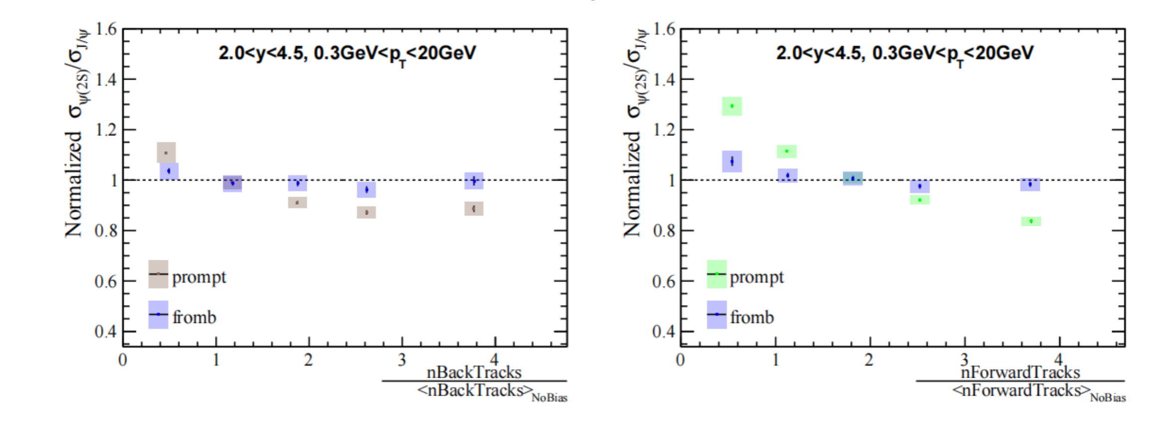
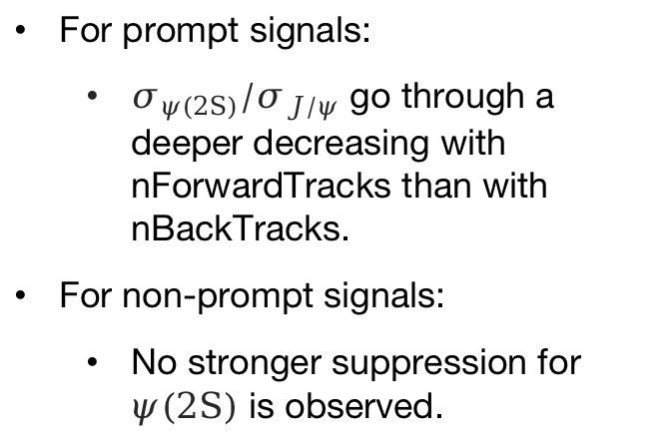
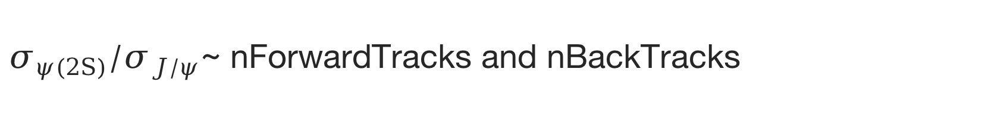
$σ_{ψ(2S)}/σ_{J/ψ}$~ nForwardTracks and nBackTracks
Normalized $σ_{ψ(2S)}/σ_{J/ψ}$~ nForwardTracks and nBackTracks:
For prompt signals:
$σ_{ψ(2S)}/σ_{J/ψ}$ go through a deeper decreasing with nForwardTracks than with nBackTracks.
For non-prompt signals:
No stronger suppression for $ψ(2S)$ is observed.
nBackTracks is measured in: $−5.2<η<−1.5$
nForwardTracks is measured in: $1.5<η<5.2$
Notes:
We can see that the when we divide multiplicity classes by nBackTracks,
the decreasing trend for prompt production become moderate compared to the results with nForwardTtracks.
Which means the correlation due to the overlap of kinematic range where we measure the multiplicity and production do has an effect on the final results.
The rapidity range for where the nBackTracks is measured is minus five point two to minus one point five. And that for nForwardTracks is measured in one point five to five point two.
Yet, within uncertainties, no matter which variable we use to divide the multiplicity calsses, the ratio for non-prompt production doesn’t vary according to multiplicity.

Slide 19
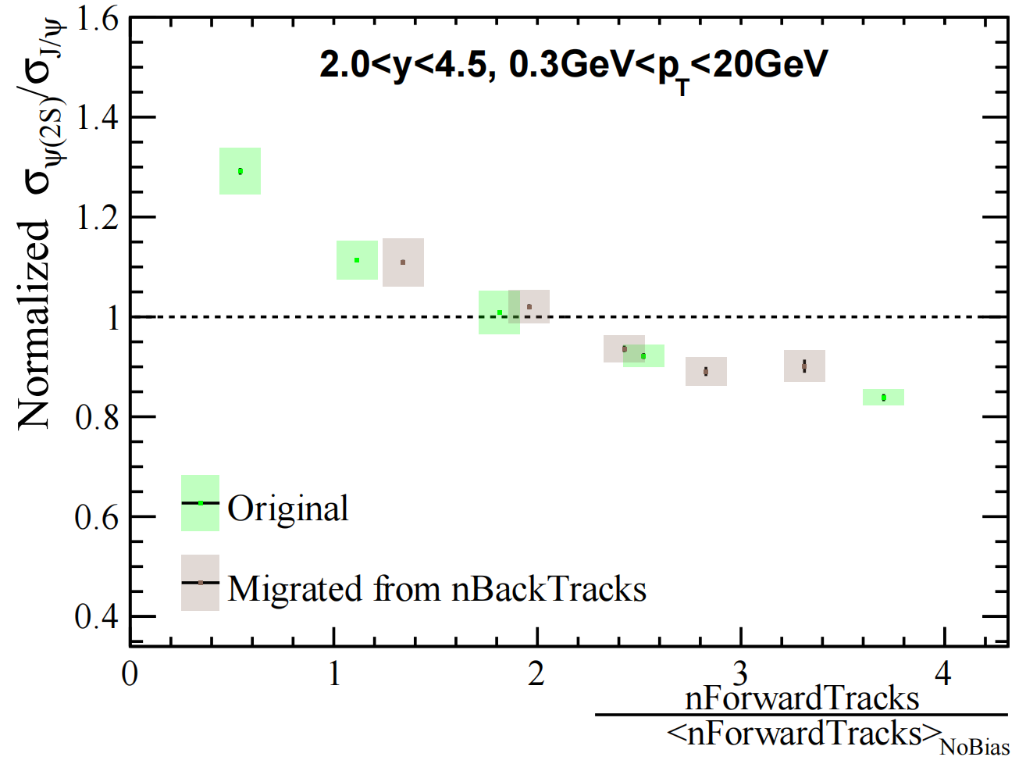
$σ_{ψ(2S)}/σ_{J/ψ}$~ nForwardTracks and nBackTracks
nBackTracks isn’t entirely independent, given a correlation of 0.54 for J/ψ and 0.51 for ψ(2S) with nForwardTracks.
Ratio of prompt production v.s. nBackTracks is plot on nForwardTracks by calculated mean value of nForwardTracks in each nBackTracks bin.
Results show that the suppression on ratio mainly result from the correlation of multiplicity and production measurements.
Notes:
We can see that the when we divide multiplicity classes by nBackTracks,
the decreasing trend for prompt production become moderate compared to the results with nForwardTtracks.
Which means the correlation due to the overlap of kinematic range where we measure the multiplicity and production do has an effect on the final results.
The rapidity range for where the nBackTracks is measured is minus five point two to minus one point five. And that for nForwardTracks is measured in one point five to five point two.
Yet, within uncertainties, no matter which variable we use to divide the multiplicity calsses, the ratio for non-prompt production doesn’t vary according to multiplicity.

Slide 20
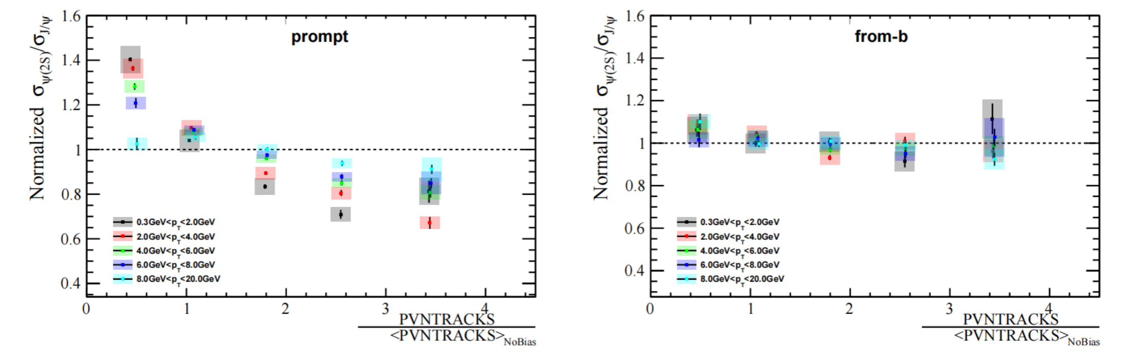
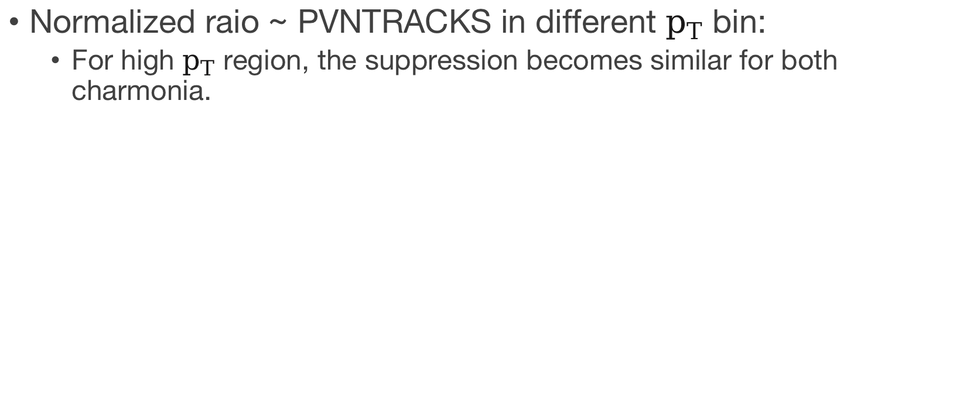

Result in different $p_{T}$ bin
Normalized raio ~ PVNTRACKS in different $p_{T}$ bin:
For high $p_{T}$ region, the suppression becomes similar for both charmonia.
Notes:
Finally we calculate the ratio in different pt bins and ybins.
We find that in high pt region, the ratio for prompt region becomes flat. The suppression become similar for both charmonia.
It may due to that there is less co-mover in high pT region.

Slide 21
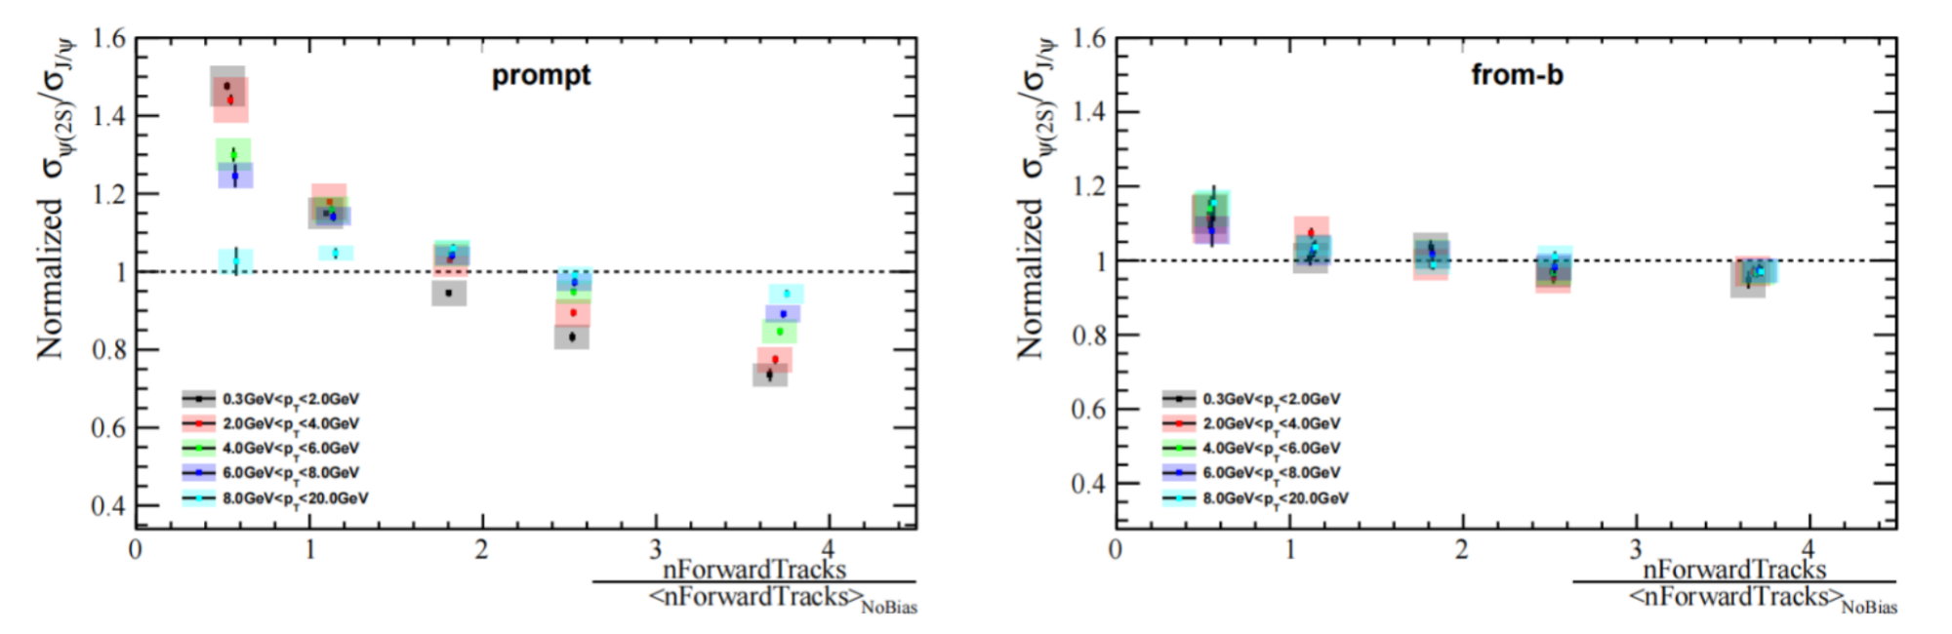
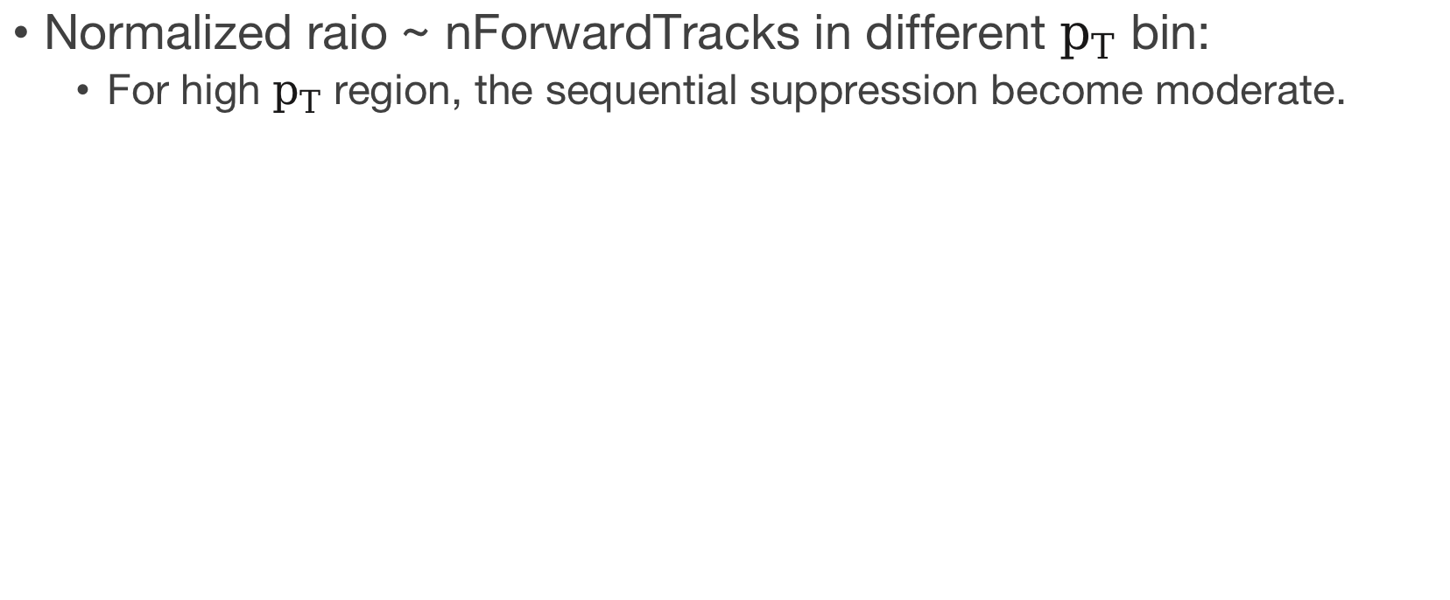
Result in different $p_{T}$ bin
Normalized raio ~ nForwardTracks in different $p_{T}$ bin:
For high $p_{T}$ region, the sequential suppression become moderate.
Notes:
This is universal no matter which variable we choose to divide the multiplicity classes.

Slide 22
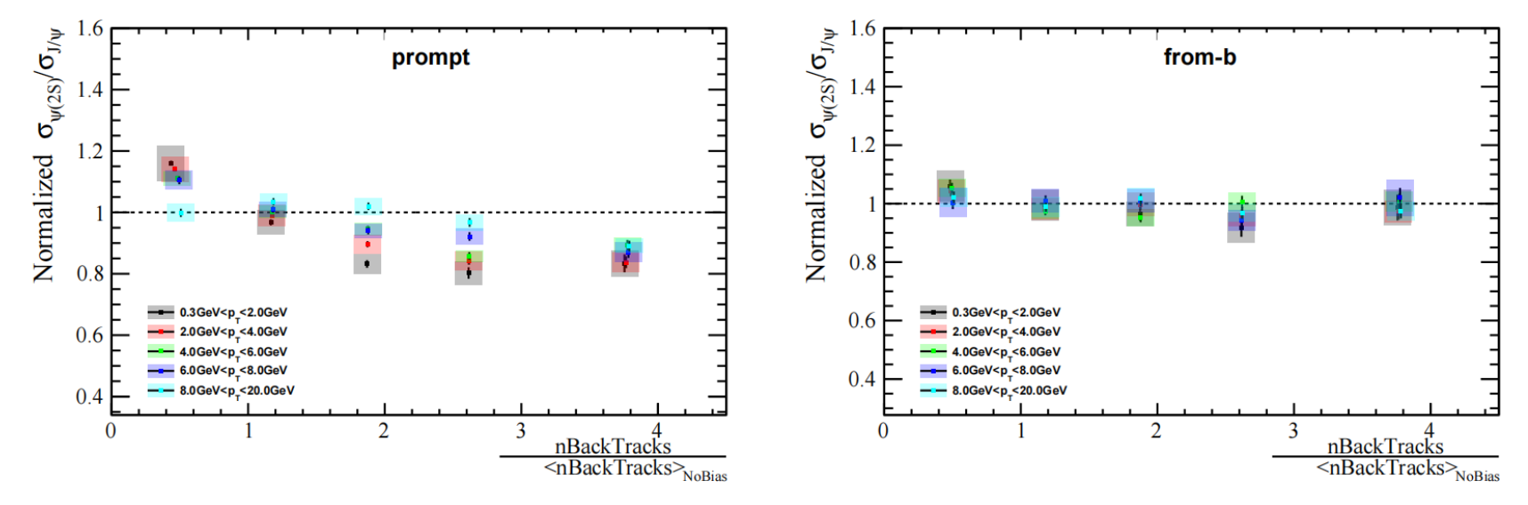
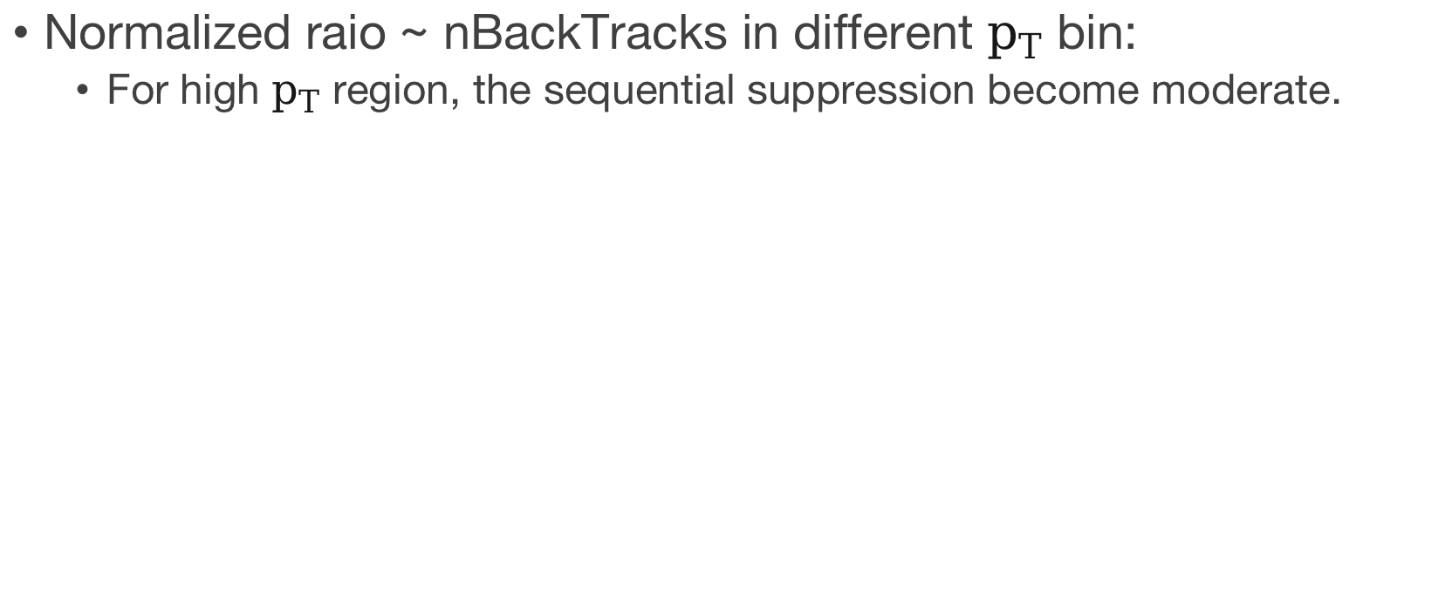
Result in different $p_{T}$ bin
Normalized raio ~ nBackTracks in different $p_{T}$ bin:
For high $p_{T}$ region, the sequential suppression become moderate.

Slide 23
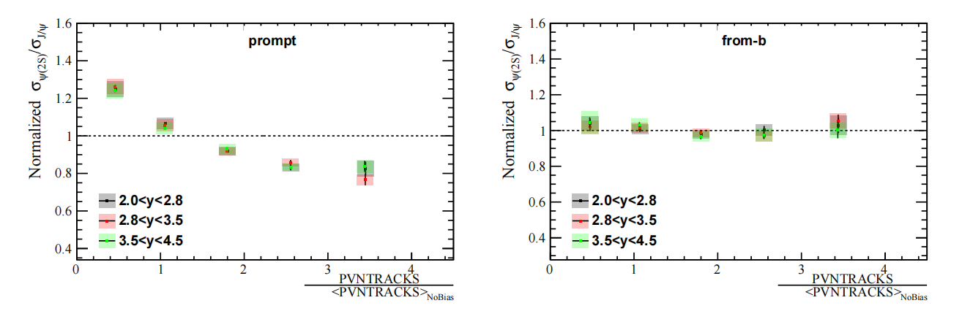
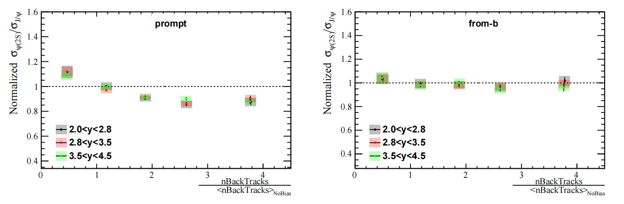
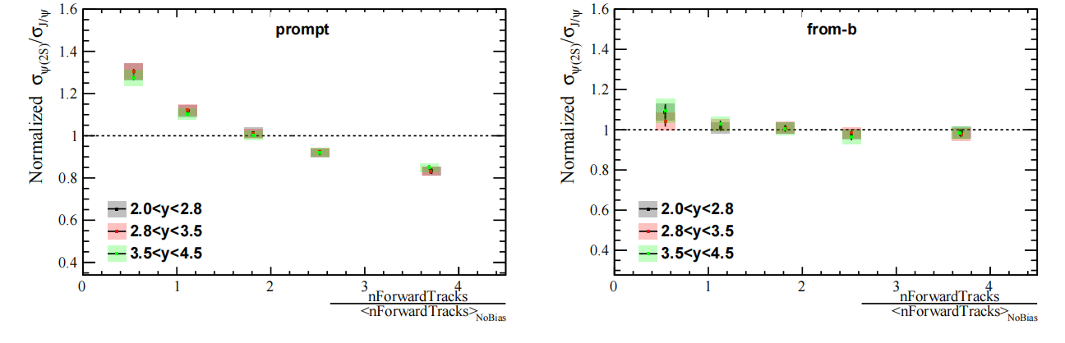
Result in different rapidity bin
The suppressions for both charmonia in different rapidity region are almost the same.
Notes:
And the result in different rapidity bins seems quite the the same.

Slide 24
Thanks for listening!

Slide 25
Back Up

Slide 26
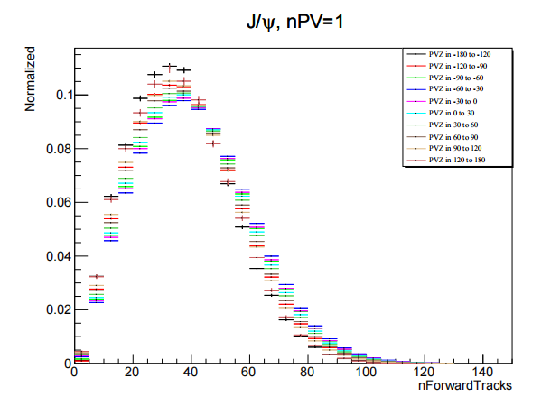
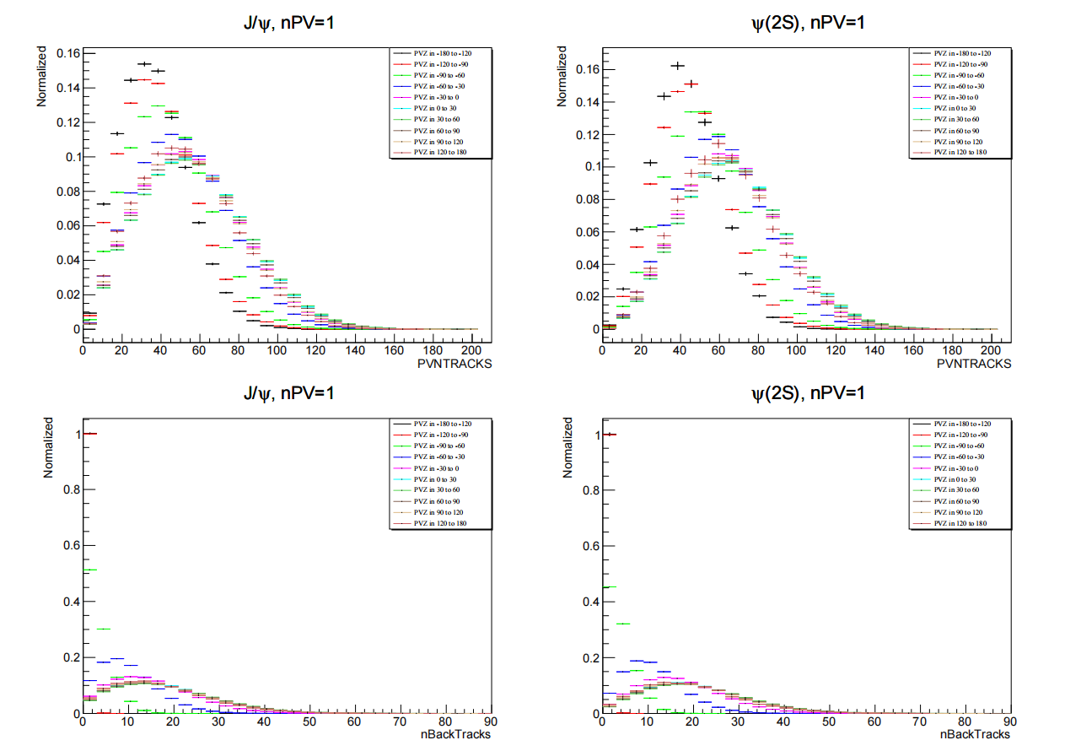
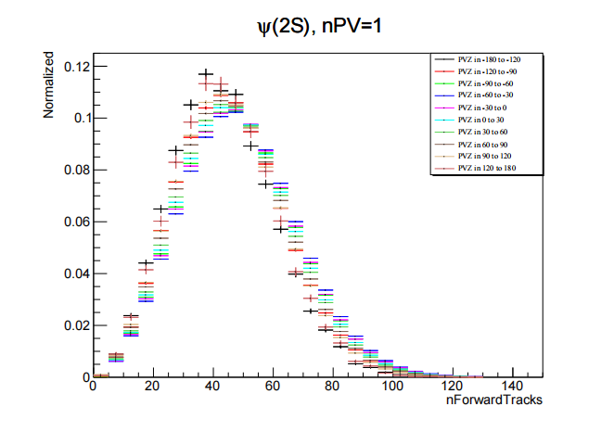
Equivalence for Velo Equivalence

Slide 27
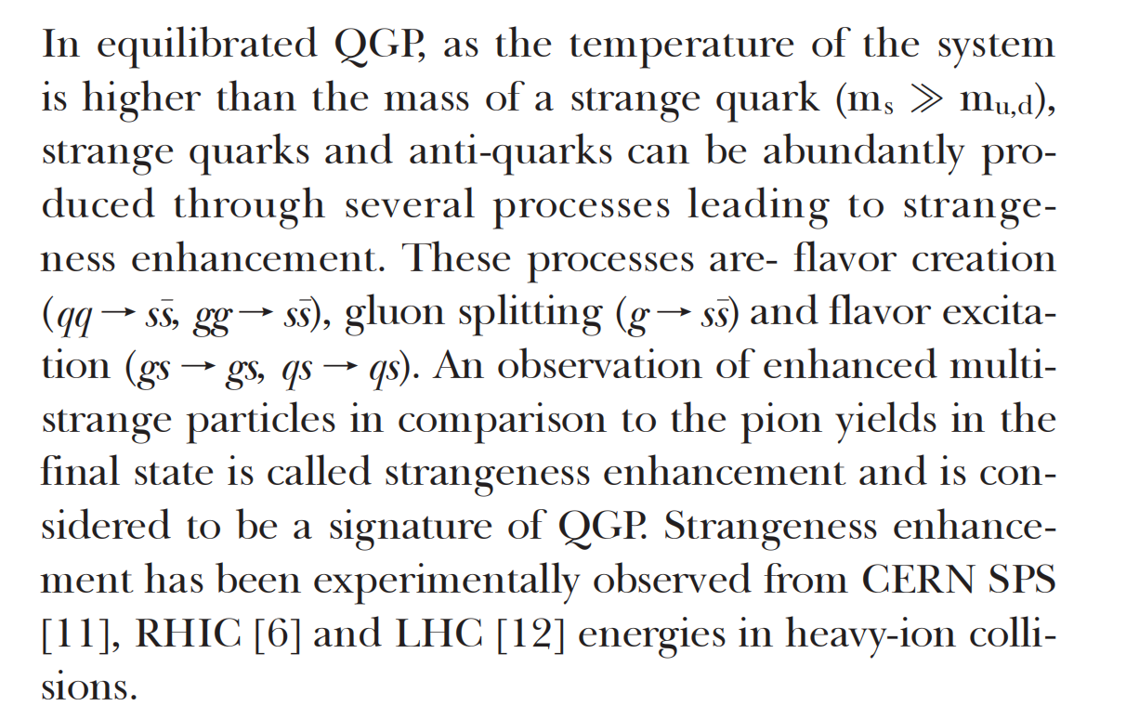
Signatures of QGP (strangeness enhancement)

Slide 28
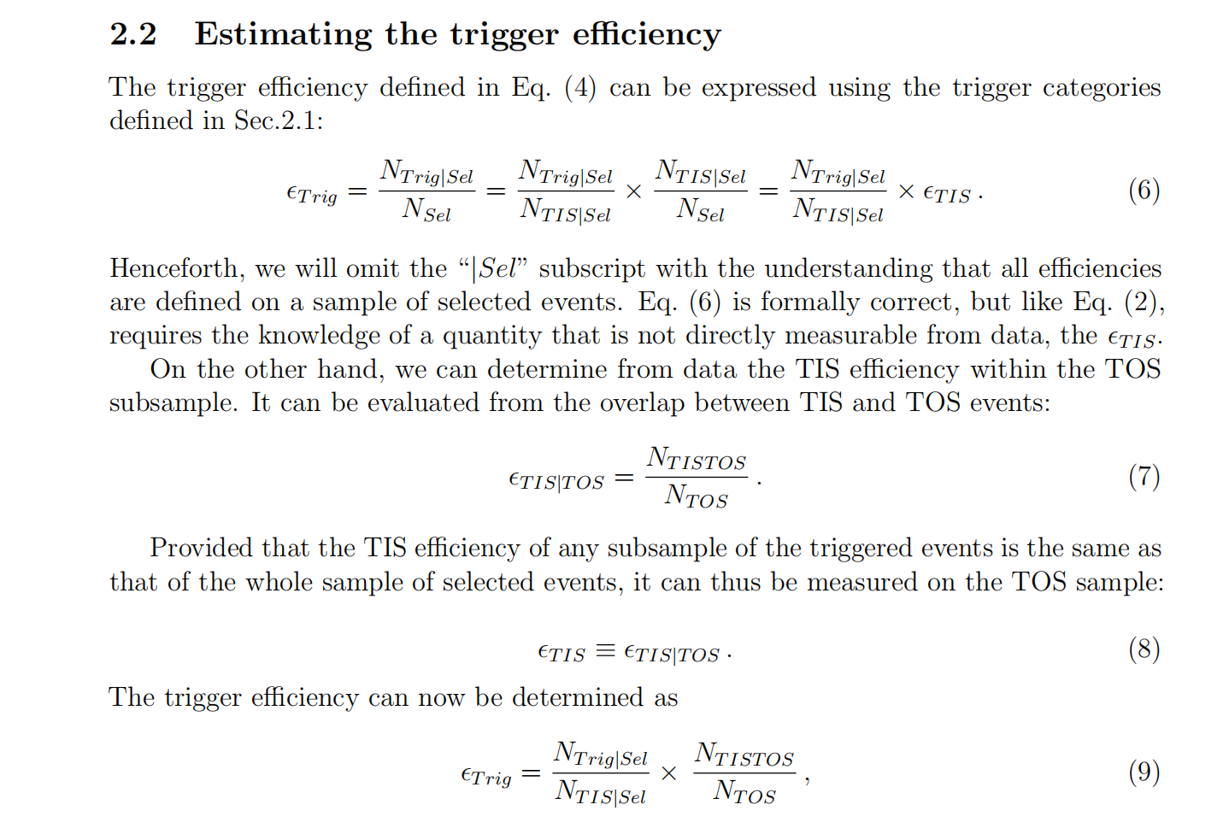
TISTOS method
LHCb-PUB-2014-039
Notes:
The point of TISTOS method is we determine the TIS efficiency with TOS subsample. Because we can not know the true TIS efficiency since only triggered events will be recorded. The detailed derivation can be seen in this article.

Slide 29
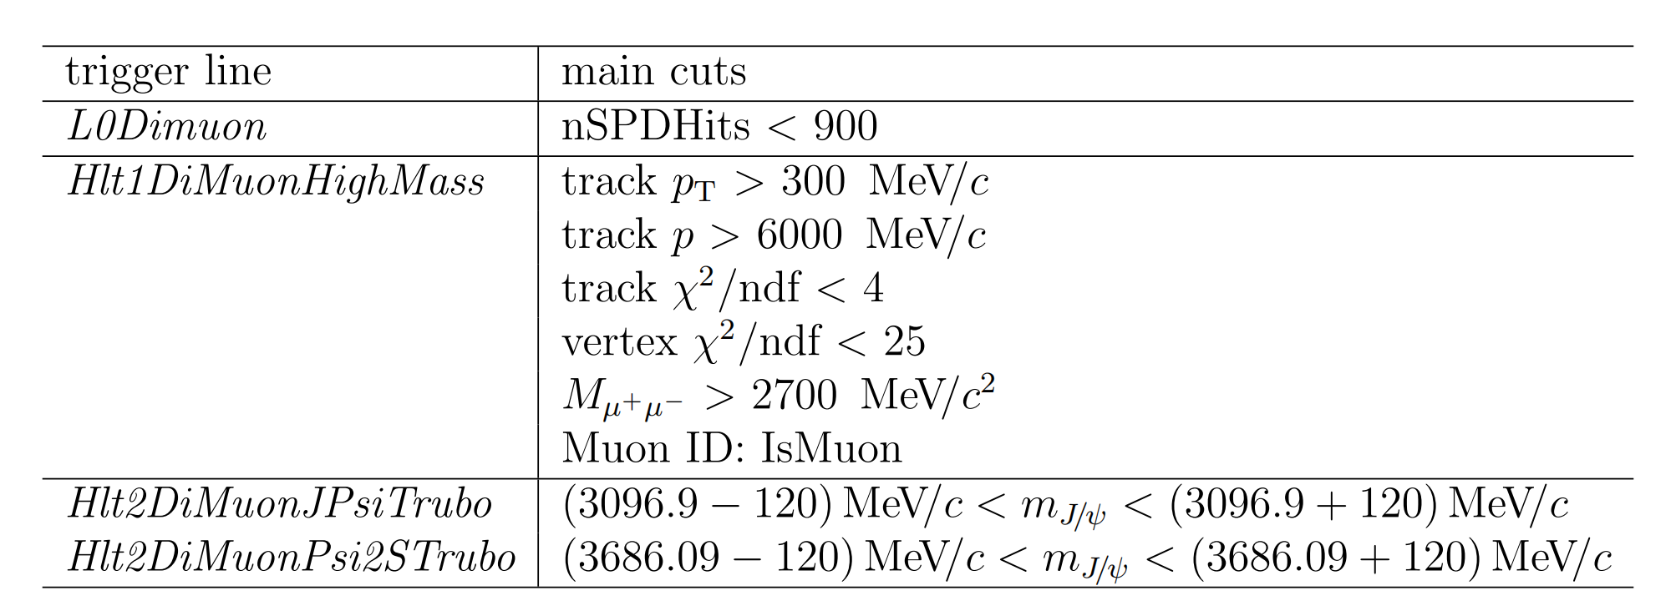
Trigger Line Cut

Slide 30
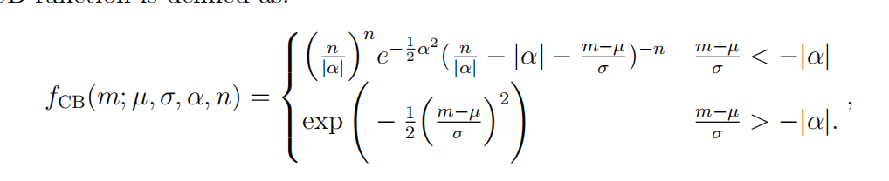
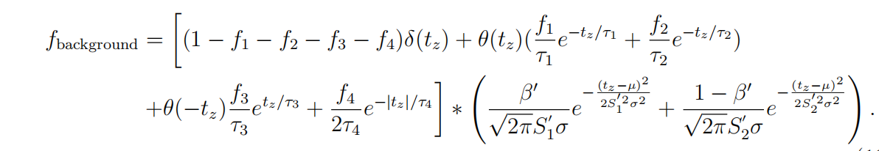
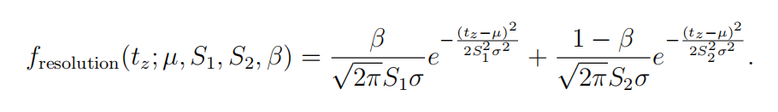
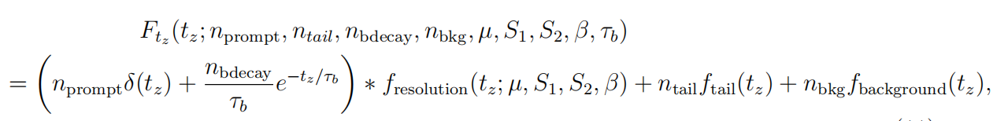
Formula for fit pdf

Slide 31
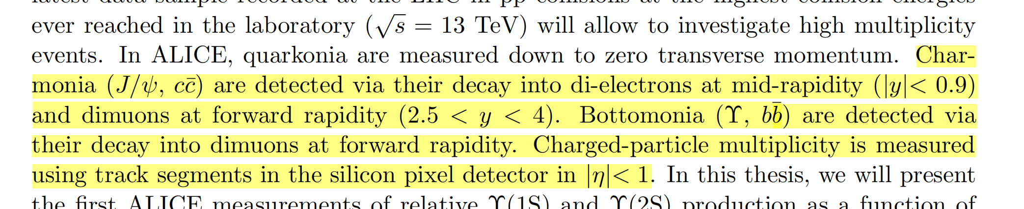
ALICE detector
charmonium through dimuons at forward rapidity (2.5 < y < 4).

Slide 32
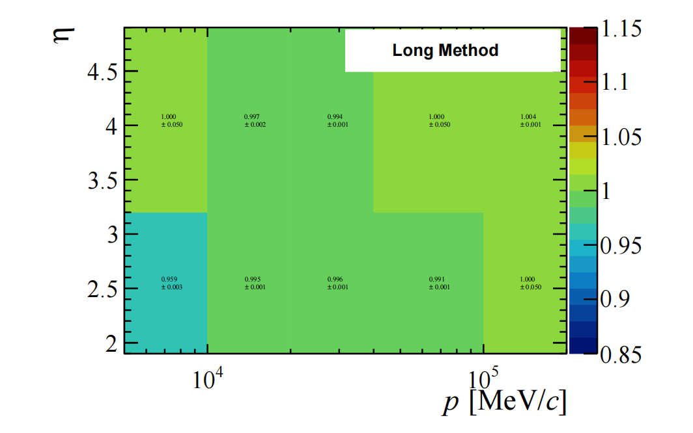
TrackCalib Table

Slide 33
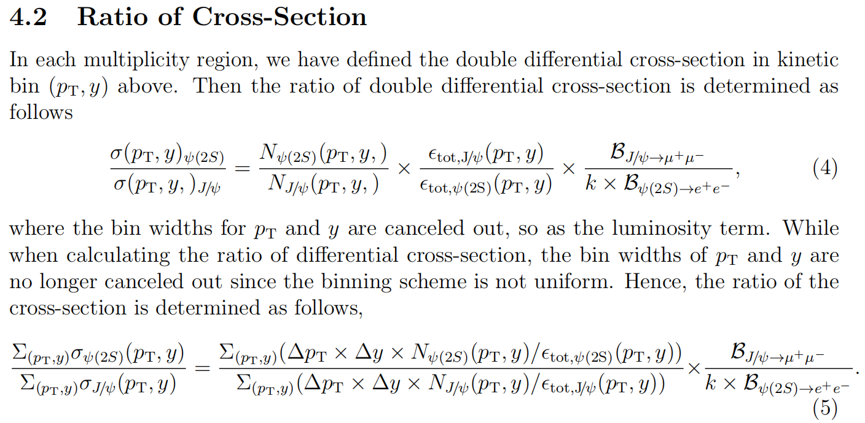
Cross section determination

Slide 34

rapidity distribution

Slide 35

Background fit
sideband sample: at least 60MeV from the center of the mass

Slide 36

certer of bin
Notes:
the distributions of multiplicity skew a lot so that in a certain bin,
the center of the bin may not represent an ideal horizontal coordinate for plotting the
results, especially for the small and large multiplicity regions. To study the effect, 10000
fitting trials are done in Monte Carlo. In each trial, in a certain multiplicity region of the
three different binning schemes (PVNTRACKS, nForwardTracks, and nBackTracks), we
randomly sample the mean values of the multiplicity region from a Gaussian sampling,
within each bin, mean being the content of the bin and width being the error of the bin.
fit. Since the data point is a ratio between two species, J/ψ, and ψ(2S), the average value for the ratio is weighted by the inverse of the square of the uncertainties (following the PDG weighted average procedure).

Slide 37

reweight separately

Slide 38

reweight separately

Slide 39

Correlation back&Forward

